Slide 1
Air quality analysis
Sooyeon Choi
Summer 2021, Phase 03

Slide 2
Clustering Analysis (K-Means)
In order to find the best analyzation for our dataset, the K-Means clustering model was ran to see how many clusters, and where the clusters were. The four data sets (four types of criteria gases) were ran separately, with the elements that had an AQI over the limit of a good-moderate pollution rate (In other words, the clusters showed the states/regions that had air pollution for each type of gas).

Slide 3
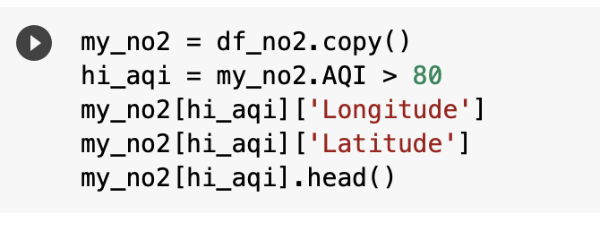
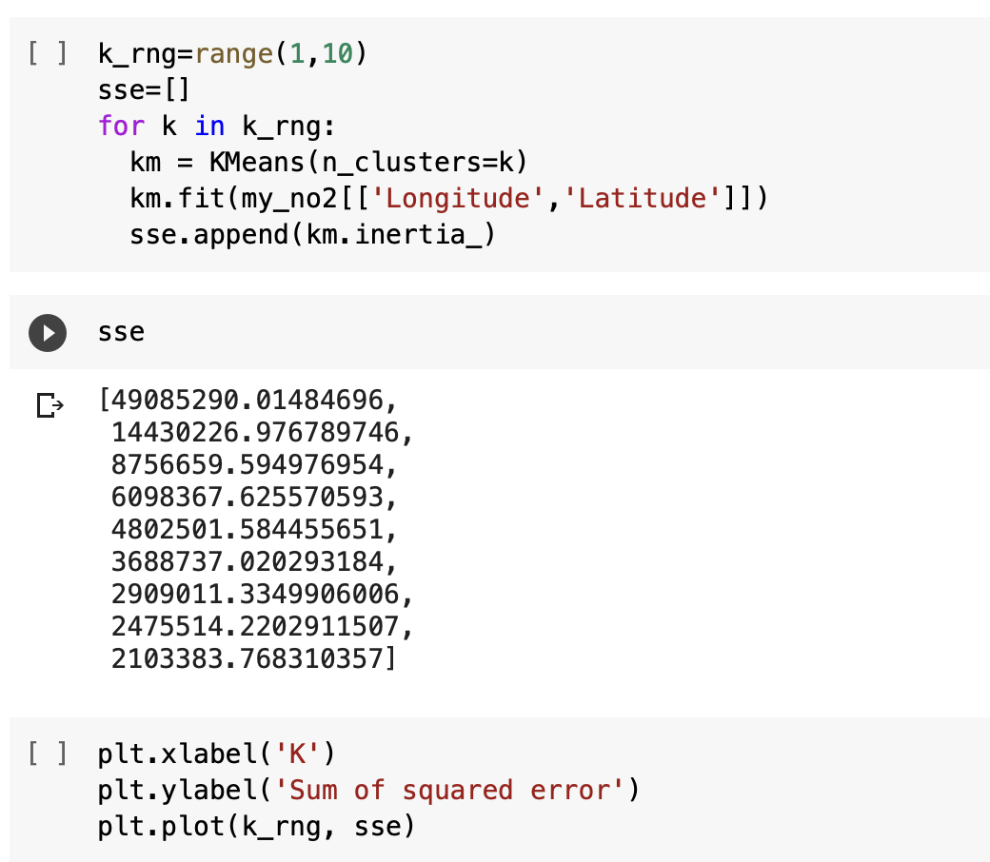
Setting boundary of the dataset to at least ’moderately polluted’
Ozone: AQI > 100
Carbon Monoxide: AQI > 10
Nitrogen Dioxide: AQI > 80
Sulfur Dioxide: AGI > 80
2. Using Longitude and Latitude for x and y
3. Compute the Sum of Squared Error (SSE) to find the number of K by the elbow method.

Slide 4
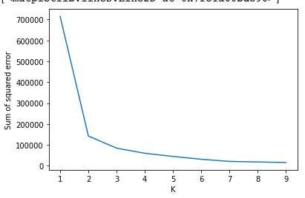
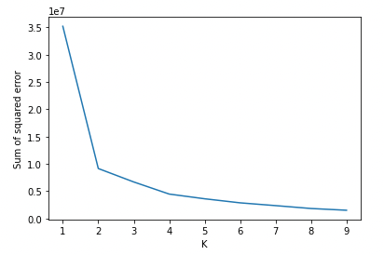
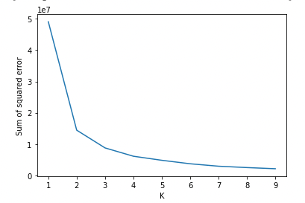
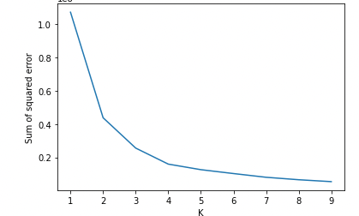
K means clustering
Elbow Method
Ozone
Carbon Monoxide
Sulfur
Dioxide
Nitrogen
Dioxide
Notes:
3,4,3,4

Slide 5
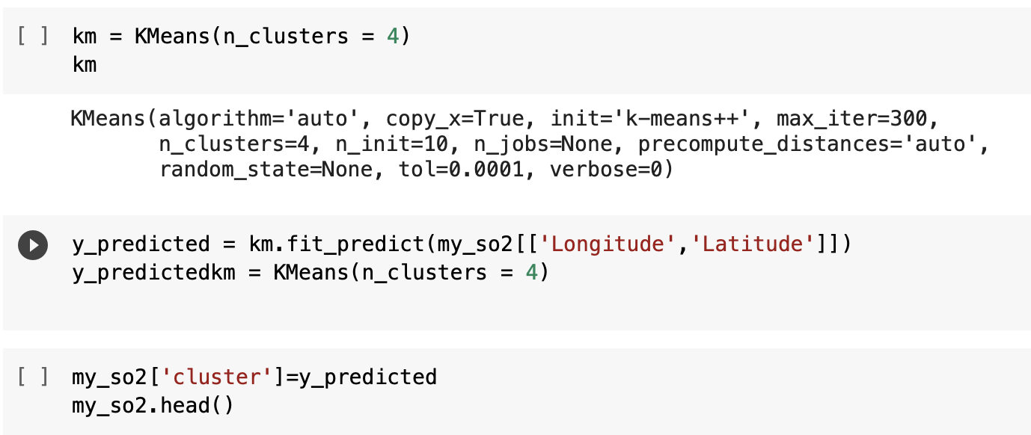
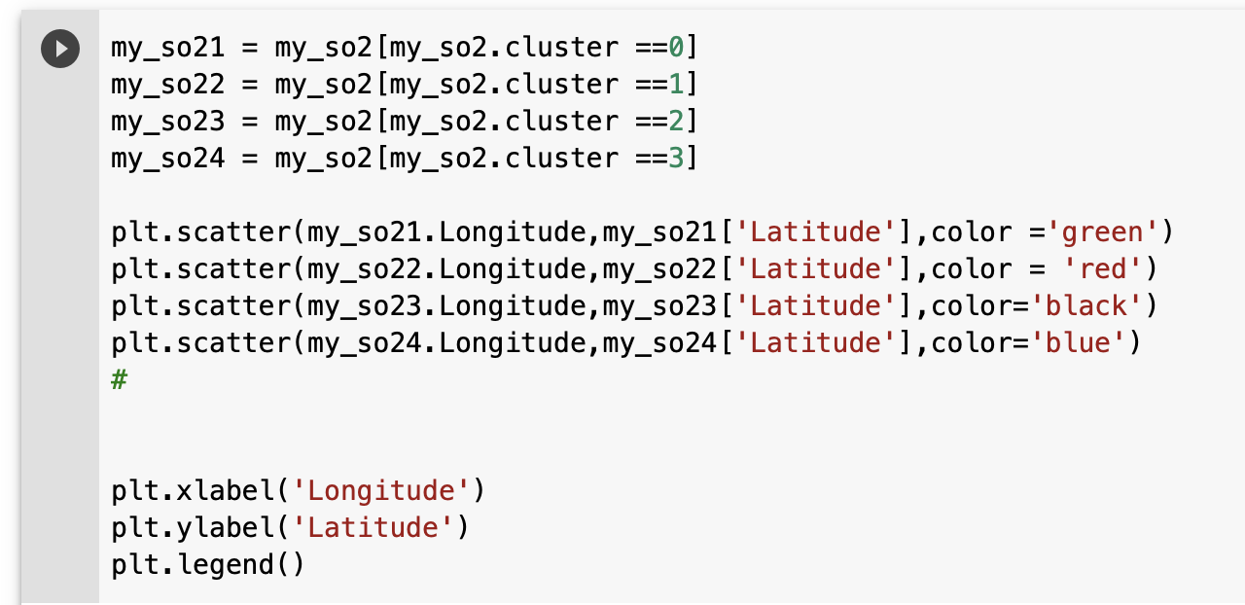
4. With the number of K clusters, generate
K-means clustering.
5. Plot the clusters

Slide 6
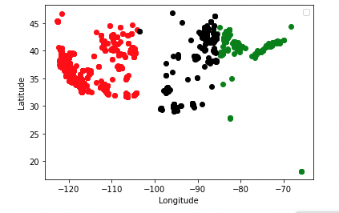
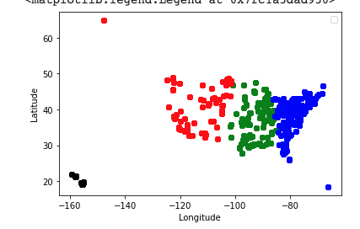
K-means Clustering
Ozone
Sulfur Dioxide
Notes:
Ozone – more than 100, sulfur dioxie- 80

Slide 7
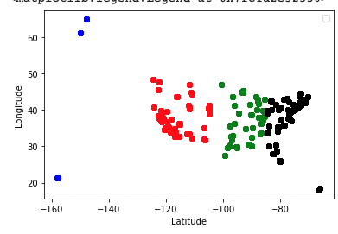
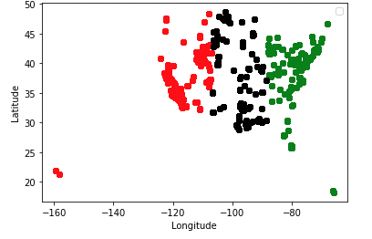
K-means Clustering
Carbon Monoxide
Nitrogen Dioxide
Notes:
Carb- 10, nit- 80

Slide 8
Solutions/suggestions
Ozone
Limiting driving
Maintain vehicles/tools well
Try to use tools without motors.
2. Carbon Monoxide
Regular inspections, maintenance
Proper storage in house
3. Nitrogen Dioxide
Manage and Reduce Emissions
Conserve energy, Less driving
4. Sulfur Dioxide
- Set regulations by State
Notes:
Ozone
- vehicles
Carbon monoxide-
Mostly indoor. carbon in fuels do not completely burn. Carbon monoxide is produced by any fuel burning appliance, vehicle, tool and more. Many of the potential sources of carbon monoxide come from malfunctioning indoor appliances
Nitrogen dioxide
Cars and trucks
Coal-fired power plants
Large industrial operations
Ships and airplanes
Sulfur dioxide –
burning of fossil fuels — coal, oil, and diesel — or other materials that contain sulfur. Sources include power plants, metals processing and smelting facilities, and vehicles.

Slide 9
Moving forward
Find more details for the clusters.
Find a detailed dataset that has the indicators for pollution.
Generate clusters using time (See when the pollution is more severe).
Think of other analysis/ machine learning that I can do with the dataset.

